Slide 1
Design Patterns
Game 253

Slide 2
Introduction
Design Patterns
Delegation
Game Loop
Scene Graph
Double Buffering
Component
Object Pool
Singleton
Decorator
Observer
Factory Method
Decorator
Composite

Slide 3
Design Patterns
A good solution to a common problem
Not always the best solution
A fair number of these you would discover implicitly

Slide 4
Delegation
An object that performs the work of another object

Slide 5
Delegation
Simplest form is a function pointer
Best-Practice is a template class delegate, with template class call-backs

Slide 6
Delegation (Implementations)
Easy Way: http://allenchou.net/2012/04/easy-c-delegates/
Fast Way: https://www.codeproject.com/Articles/13287/Fast-C-Delegate

Slide 7
Why Delegate?
If 2 systems need to interact, and doing so in the game loop would be too costly
Behaviour needs to be altered at any time
Input
UI and Entities
Event Handling

Slide 8
Game Loop
A way to structure games that render frame-by-frame with movement calculated between frames

Slide 9
Game Loop
All games:
  Handle input
  Perform game logic
  Render the game
Create a loop that repetitively performs the operations in rendering a frame in a game

Slide 10
Game Loop

Slide 11
Game Loop Considerations
Only those things that need to update should have an update method
Only those things that need to render should have a render method
Remember class specialisation, wherever your game loop is, that is all that should be there

Slide 12
Scene Graph
A technique to represent all objects in the scene making it easier to organise the scene

Slide 13
Scene Graph
Makes rendering easier
Allows organising a series of sub-objects into one object
A data structure that stores position, orientation, and scale

Slide 14
2D / 3D Scene Graphs
2D may be a simple array of objects, especially for a tile based game
3D more often has a scene graph where each node has a parent node, and [0..*] child nodes

Slide 15
Scene Graph

Slide 16
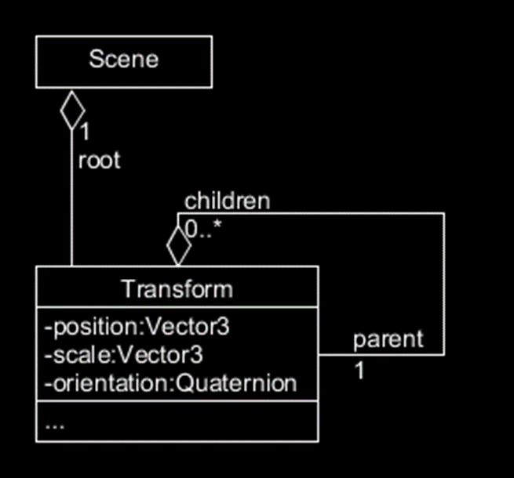
Scene Graph
A simple implementation that makes transforms into nodes of a tree

Slide 17
Double Buffering
Drawing the frame to a buffer, and the last buffer to the screen.

Slide 18
Double Buffering
Maintain 2 pointers, draw everything to one, and draw the other to the screen
swap the 2 pointers Every Frame
More performance friendly

Slide 19
Component
Distinct logical components with specialised roles

Slide 20
Component
Separate responsibilities into separate classes
Decorate objects with components to add responsibilities to the objects
Behaviours become independent, changes in one don’t affect the others

Slide 21
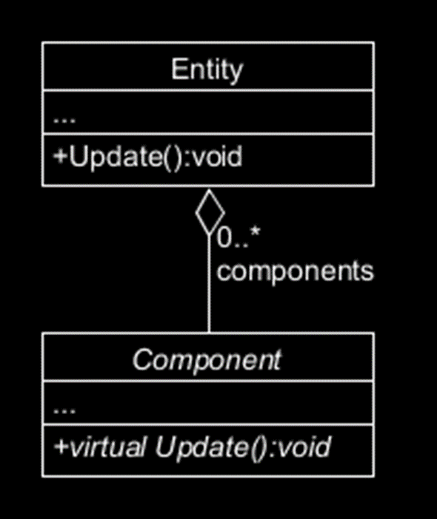
Component
A simple implementation that adds additional behavior to entities.
Does not ensure that only those things that need to update do

Slide 22
Why Components?
Easier to maintain and debug
Creates reusable logical units
Separates behaviour into specialised classes

Slide 23
Object Pool
Holds a collection of objects that are expensive to create or destroy

Slide 24
Object Pool
Create a large collection of objects
Track the ones in use, and the ones not in use
Instead of creating new objects, creation passes one not in use
Similarly deleting becomes setting the object to not in use
Fewer constructor / destructor calls

Slide 25
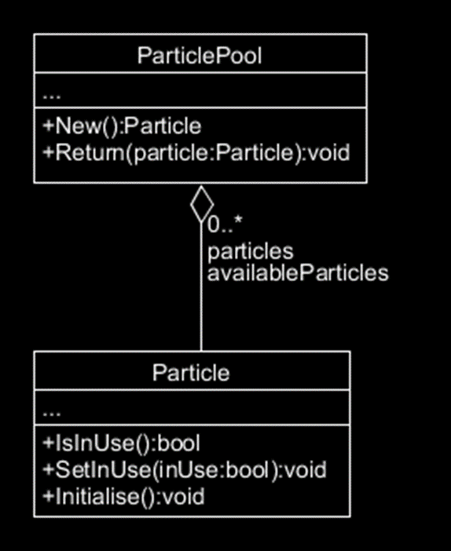
Object Pool
A simple implementation for a particle pool

Slide 26
Why Object Pool?
Constant creation and destruction of objects is expensive
Standardises a common need for objects on the fly in a performance friendly way

Slide 27
Singleton
Guarantee that only one instance of the class exists

Slide 28
Singleton
Useful in situations where only one instance of a class should exist:
  One game engine
  One physics engine
  One graphics API

Slide 29
Singleton

Slide 30
Decorator
An object that can decorate another object giving it extra functionality

Slide 31
Decorator
In some cases behaviour from a component could require additional functionality be dynamically introduced or removed.
World Generation:
  World Pass (Generates Terrain)
  Tree Decorator
  Town Decorator
UI:
  Text
  Vertical Scroll Decorator

Slide 32
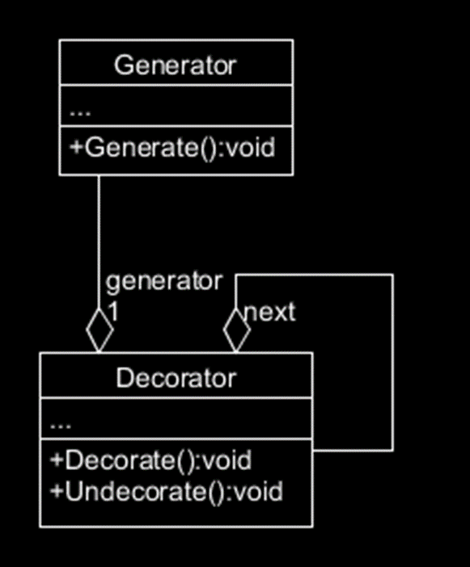
Decorator
A simple implementation of the decorator pattern for generator, where Decorate() is called for each Decorator in Generator on Generate()

Slide 33
Let's Review Class & Sequence Diagrams
Stick around if you want to go over some examples in class / talk about grades.

